Slide 1
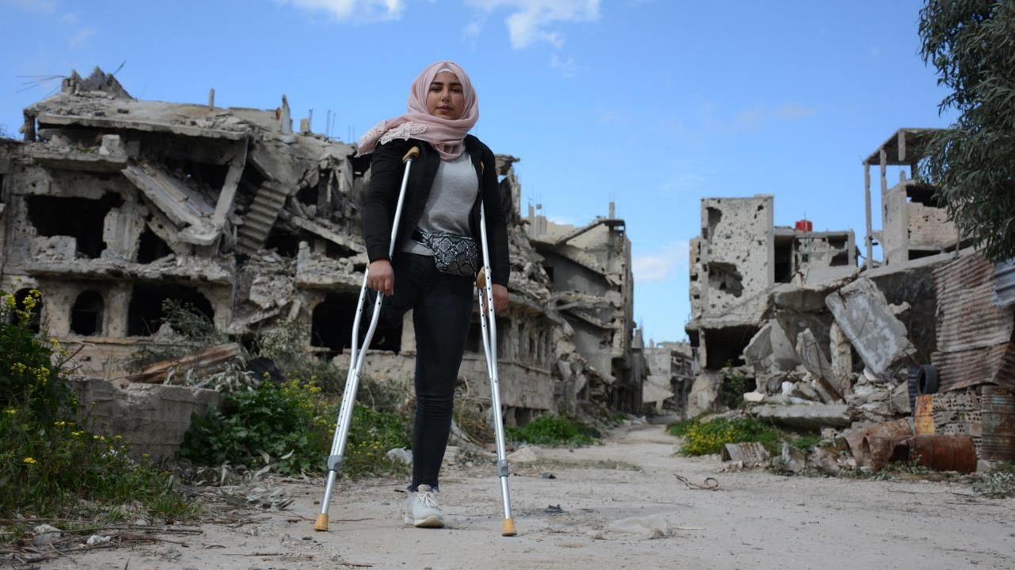
Disability Inclusion in HNOs/HRPs/HNRPs progress and learning
Disability Advisory Group
2024

Slide 2
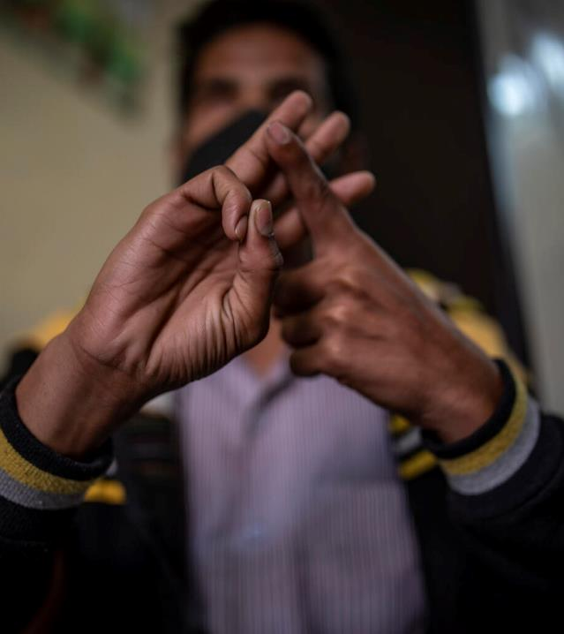
Disability Advisory Group
Led by UNICEF, with participation by CBM-International, FCDO, Global Education Cluster, Global Protection Cluster, Humanity & Inclusion, Impact Initiatives, IOM, OCHA, Trinity College Dublin, UNHCR, and WFP
Focus on disability inclusion in Humanitarian Needs Overviews and Humanitarian Response Plans, since 2018
Annual review of HNOs/HRPs/HNRPs
Space for interagency dialogue and learning
Technical support to HNO/HRP/HNRP processes- guidance and tools, trainings

Slide 3
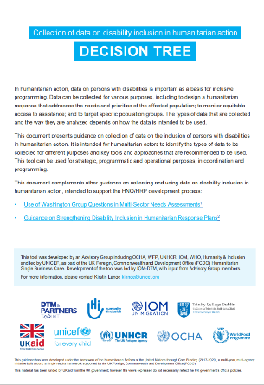
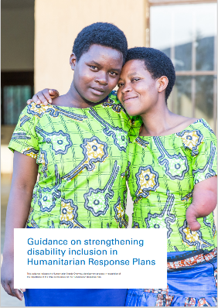
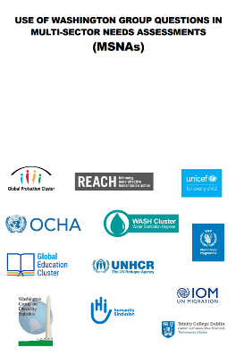
Key resources developed by the DAG
Notes:
HNO/HRP guidance- Guidance on strengthening disability inclusion in Humanitarian Response Plans - World | ReliefWeb
Decision tree- PowerPoint Presentation (iom.int)
MSNA guidance- Guide_WGQs_in_MSNAs_toshare_final.pdf (impact-initiatives.org)

Slide 4
2024 HNO/HRP/ HNRP review
10 HNOs/ HRPs
Burkina Faso
15 HNRPs
Afghanistan
Cameroon
CAR
DR Congo
El Salvador
Ethiopia
Guatemala
Nigeria
Syria
Yemen
Chad
Haiti
Honduras
Mali
Mozambique
Myanmar
Niger
Somalia
South Sudan
Sudan
Ukraine
Inter-agency collaboration
OCHA
CBM- International
UNHCR
IOM
Global Education Cluster
Global Protection Cluster
WFP
Trinity College Dublin
Impact Initiatives
Coordinated by UNICEF, with:

Slide 5
Progress to date: Needs assessment
2022- Development of guidance with REACH- use of Washington Group Questions in MSNAs
In 2018, no HNOs provided a disaggregated PIN. In 2023, 91% of HNOs disaggregated PIN by disability
In 2018, 17% of HNOs provided a description of the needs of persons with disabilities. In 2023, 82% provided a comprehensive description
In 2023, 84% of HNOs addressed disability inclusion in 5 or more cluster chapters
Notes:
Progress to 2023 (pre-HNRP)

Slide 6
Reliability of data
Fully meeting:
PIN is disaggregated based on sound primary data collection or reliable secondary data sources and reliable data on persons with disabilities are consistently presented
OR
Evidence-based global estimates (15%) are used, and reference is made to the need to strengthen data collection and analysis
OR
Reference is made to use of Washington Group Questions, but this resulted in lower-than-expected prevalence
52.4% of countries use global estimates
19% of countries collected primary data
Notes:
Not meeting 9%
Partially meeting 59%
Fully meeting 32%

Slide 7
Good practice examples
Compared to households with members without disabilities, households with members with disabilities are: 22% more likely have children drop out of school due to disability, 12% more likely to adopt an emergency livelihood coping mechanism, 20% more likely to resort to begging to buy food, 21% more likely to accept child marriage to buy food (Nigeria)
Although limited data is available, 5 million people with disabilities are estimated in Yemen, based on the World Health Organization’s (WHO) global estimate of 15 per cent of the total population. This number is likely to be much higher, given the extent of conflict-related casualties over recent years and high prevalence of landmines and explosive remnants of war, among other challenges (Yemen)

Slide 8
Risk/ needs analysis
Fully meeting:
HNO comprehensively describes the factors contributing to heightened risk for persons with disabilities, including specific barriers to accessing assistance
Notes:
Not meeting- 32%
Partially meeting- 18%
Fully meeting- 50%

Slide 9
Good practice examples
Households headed by or living with members with a disability typically experience higher food insecurity levels as they incur additional costs for healthcare and assistive devices, spend more time on care, and disproportionately struggle to access income opportunities, with 59 per cent reporting gifts or begging as the primary household income source. Lack of mobility and access to transportation is a specific challenge during community displacements due to sudden shocks such as floods or an escalation in violence. In displaced settings, people with disabilities often miss out on assistance and critical information as they are not included in decision processes; physically struggle to access WASH, health and education facilities; and may be forced to live in particularly risk-prone and unsafe shelter conditions in informal and unplanned settlements (Somalia)
Some 45 per cent of IDPs indicate that latrines are not adapted for persons with disabilities. In the North West and South-West, obstacles on the way are cited as the main impediment to access education and food, followed by fear of harassment and negative community perception of disabilities (Cameroon)

Slide 10
Recognition of diversity
Fully meeting:
HNO recognizes diversity among persons with disabilities and describes how social and political identities intersect with disability to impact on experience of risk
Notes:
Not meeting- 45.5%
Partially meeting- 36.5%
Fully meeting- 18%

Slide 11
Good practice examples
Age may interact with disability to exacerbate exclusion. For example, older persons with disabilities may be expected to be cared for by their families, thus increasing isolation and risk of exploitation… Persons with disabilities from minority ethnic or religious groups or those associated with certain political groups may face compounding forms of discrimination (El Salvador)
Moreover, for women, girls, and children with physical, cognitive, and intellectual disabilities, they suffer multiple violences based on gender inequality, facing higher risks of sexual exploitation, including possible exploitation and sexual abuse by humanitarian aid providers (Honduras)

Slide 12
Cross sectoral attention
Notes:
Not meeting- 18%
Partially meeting- 36%
Fully meeting- 18%
NA (no sectoral chapters)- 27%

Slide 13
Good practice examples
Children with disabilities have lost access to education due to the destruction of school infrastructure (as temporary learning centres rarely have accessibility features) and ongoing stigmatization. There is also a lack of sufficient teachers to support inclusive learning, especially in the non-formal education stream. (Education, Myanmar)
Children with disabilities face a higher risk of malnutrition due to various factors, including feeding difficulties, frequent illnesses, societal stigma and discrimination and neglect. (Nutrition, Cameroon)
Les personnes handicapées (représentant 6,9% de la population selon MSNA 2023) sont deux fois plus susceptibles d’avoir des besoins de santé (66% contre 33% pour les sans handicaps), et trois fois plus susceptibles d’avoir des besoins de santé non comblés (31,4% contre 10% pour les personnes non handicapées) (Health, CAR)

Slide 14
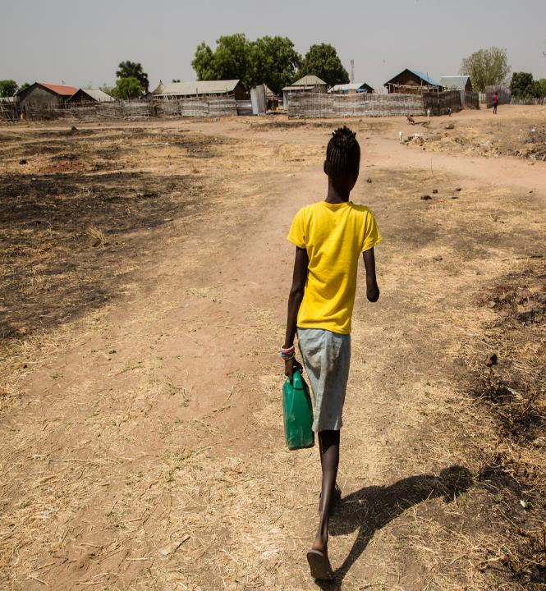
Common challenges
Unexpectedly low PIN or inconsistency between PIN in topline data and in narrative
Presenting persons with disabilities among a list of ‘vulnerable groups’, without further analysis. Or description of needs without analysis of underlying factors
Little reflection of diversity among persons with disabilities, and impact of intersecting factors on risk and need

Slide 15
Overall progress HNO/ needs analysis
 | 2018 (baseline) | 2022 | 2023 | 2024
Reliability of data | 0 disaggregated PIN 25% included any disability data | 78% | 91% | 90.5%
Risks/ needs analysis | 17% | 91% | 82% | 71.5%
Monitoring situation and needs |  | 57% | 50% | Not included in review
Recognition of diversity | 11% | 83% | 82% | 57%
Cross sectoral attention (in 5 or more sectors) |  | 64% | 84% | 43%
Notes:
%s refer to HNOs partially or fully meeting expectations, according to review criteria.

Slide 16
Progress to date: Response Planning
In 2018, 10% of HRPs referred to mainstreaming of disability inclusion. In 2023, 84% described a comprehensive response to the needs of persons with disabilities
In 2018, 19% of HRPs reflected disability inclusion in monitoring frameworks. In 2023, 80% presented either disaggregated or specific indicators for disability inclusion
In 2018, 29% of HRPs mentioned consultation with persons with disabilities or accessibility of CFMs. In 2023, 84% described inclusive AAP mechanisms
In 2023, 80% of HRPs addressed disability inclusion in 5 or more cluster chapters (compared to 43% in 2021)
Notes:
Progress to 2023 (pre-HNRP)

Slide 17
Comprehensive response
Fully meeting:
A clear reflection of a twin-track approach (targeted AND mainstreaming activities), with concrete description of activities
Notes:
Not meeting- 14%
Partially meeting- 52%
Fully meeting- 33%

Slide 18
Good practice examples
In 2024, the [Disability Inclusion Working Group] DIWG will continue building the capacity of humanitarian actors on disability inclusion, provide technical support on developing and reviewing inclusive proposals and tools, and support systematic disaggregated data collection and analysis from an age, gender, and disability perspective. (Afghanistan)
In Ukraine, barriers identified include lack of access to banking services, especially in rural areas, a lack of participation of people with disabilities in program planning, and the need for better information on cash assistance. Recommended solutions consist of using at least two financial providers, involving community mobilizers and volunteers in registration, ensuring referrals for protection and other sectoral needs and diversifying communication methods (Ukraine)

Slide 19
Participation and engagement of OPDs as local actors
Fully meeting:
The HRP identifies how persons with disabilities and their representative organizations will participate as actors in the response
Notes:
Not meeting- 62%
Partially meeting- 19%
Fully meeting- 19%

Slide 20
Good practice examples
In 2024, the [Technical Advisory Group] TAG on Disability Inclusion will collaborate with the ICCG to work on four crucial areas: 1. Consultation: Support and empower local OPDs to reach those most in need. Provide a platform for OPDs to input into the wider humanitarian response… (Myanmar)
En vue de promouvoir une programmation humanitaire inclusive, les acteurs humanitaires s’engagent, notamment à (...) consulter les PSH ainsi que les organisations qui les représentent ; identifier les obstacles les empêchant d’accéder et de participer à l’assistance et à la protection humanitaire ; garantir la participation pleine et effective des PSH à l'aide humanitaire (Mali)

Slide 21
Feedback and complaints
Fully meeting:
Persons with disabilities have been considered in the design of feedback and complaints systems with a description of specific measures to ensure their accessibility
Notes:
Not meeting- 76%
Partially meeting- 33%
It is important to highlight that this rating may not fully reflect the extent to which feedback and complaints mechanisms are disability inclusive in HRPs/HNRPs. The review process did not delve into external links or references to AAP that may contain more detailed information on disability-inclusive complaints and feedback mechanisms.

Slide 22
Monitoring framework
Fully meeting:
One or more indicators are specifically monitoring disability inclusion

Slide 23
Good practice examples
Specific indicators:
Number of disability inclusive sanitation facilities designed (South Sudan)
% of persons with disabilities reporting to be satisfied with the opportunities they have to influence decisions (Mozambique)
# of girls and boys with Disability received PSS or case management services (Sudan)
Disaggregation by disability:
# De personas empleo y apoyo al emprendimiento en contextos de emergencia y procesos de soluciones duraderas desagregado por género, discapacidad, etnia y ciclo vital (Colombia)
% de bénéficiaires (ventilé par sexe, âge et handicap) ayant déclaré que l'aide humanitaire est fournie de manière sécurisée, accessible; responsable et participative (DRC)
Number of people having access to basic hygiene materials for handwashing and menstrual hygiene health (disaggregated by age, gender and disability) (Mozambique)
% of projects targeting a minimum of 15% of people with disability
% of persons with disabilities employed in the humanitarian response
% of organizations who collects/analyze/report disability disaggregated data
Number of cluster partners projects that have a disability component or are targeting people with disabilities.
(Afghanistan)

Slide 24
Sectoral coverage
Notes:
Not meeting- 9.5%
Partially meeting- 52.5%
Fully meeting- 32%

Slide 25
Good practice examples
An analysis of alternative learning options for these children and youth, including those with disabilities, (including) accelerated education programs, literacy and numeracy, life skills training, etc It includes the provision of semi-temporary learning spaces to increase school capacity, as well as latrines and water points accessible to all children, including those living with disabilities… Purchase and distribution of inclusive and sexes specific supplies to children with disabilities. (Education, Cameroon)
CCCM will continue to scale up community consultations with an emphasis on ensuring that services are fully accessible by persons with disabilities… Generating inclusive community governance structures that include meaningful involvement of persons with disabilities. (CCCM, Mozambique)
The FSLC will work in collaboration with the Protection Cluster and Disability Inclusion Working Group to identify access barriers and identify measures to address these effectively. FSLC Partners will work closely with local authorities to ensure clarity on vulnerability criteria and support needed for people with disabilities to access their entitlements in a safe and dignified manner. (Food security and livelihoods, Mozambique)

Slide 26
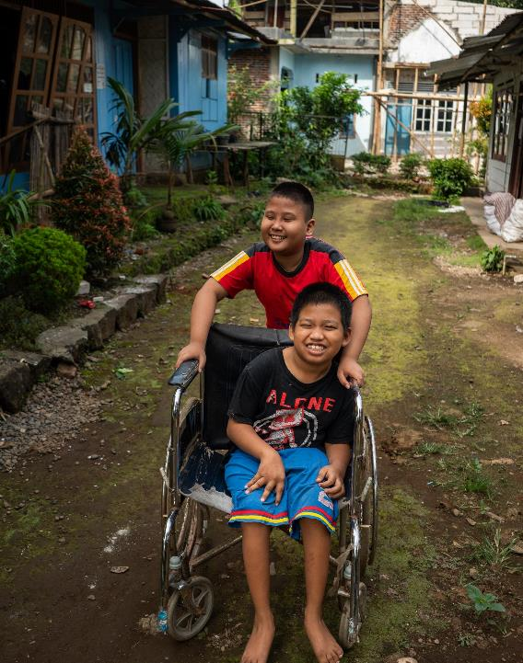
Common challenges
General statements such as ‘the response will prioritize vulnerable groups, including women, children and persons with disabilities’ is still seen in some countries.
In some HRPs/ response planning section of HNRPs, the document re-iterates the needs of persons with disabilities but without corresponding actions to address these.
Engagement of OPDs as local actors remains a challenge
Accessibility of feedback and complaints is rarely addressed (in main document)

Slide 27
Overall progress HRP/ response planning
 | 2018 (baseline) | 2022 | 2023 | 2024
Monitoring the response | 19% | 80% | 80% | 95%
Sectoral coverage |  | 52% | 80% | 84.5%
Reflection of diversity |  | 36% | 52% | Not included in review
Comprehensive response | 10% refer to mainstreaming and 19% to specialized services | 76% | 84% | 85%
Feedback and complaints | 29% mention consultation with persons with disabilities and/or access to CFMs | 60% | 84% | 33%
Participation | 19% | 32% | 45% | 38%
Notes:
%s refer to HRPs fully or partially meeting expectations, according to review criteria.
It is important to highlight that the feedback and complaints rating for 2024 may not fully reflect the extent to which feedback and complaints mechanisms are disability inclusive in HRPs/HNRPs. The review process did not delve into external links or references to AAP that may contain more detailed information on disability-inclusive complaints and feedback mechanisms.

Slide 28
Lightened documents- key shifts for disability inclusion
In 2024, HNO format more strongly reflected disability inclusion, compared to HNRP format
Consistent on presentation of disability data
Less detailed description of needs and underlying factors, especially for sectoral chapters
In 2024, HNRP format more strongly reflected disability inclusion, compared to HRP format
Consistent on description of an inclusive response
Improvement in disability inclusive monitoring
Gaps in description of inclusive AAP mechanisms (in main document)
Notes:
Needs analysis:
There was mixed progress on disability inclusion in 2024 HNOs/ HNRPs, compared to previous years. Reflection of reliable data on persons with disabilities continued to be strong, with nearly all HNOs/ HNRPs fully or partially meeting expectations. There was some decrease in the quality of description of needs of persons with disabilities- while there continued to be many strong examples of quality analysis under the new HNRP format, highlighting the possibility to retain this level of quality- more countries did not include a clear analysis of the risks facing persons with disabilities and underlying factors. With less space for detailed analysis, there was more limited reflection of diversity of needs among persons with disabilities; and sectoral chapters in particular had less attention to disability than in previous years, highlighting potentially a need to identify other documents within which more detailed description of sectoral needs may be included (e.g. cluster strategies).
When HNO and HNRP format were compared, countries using the HNO format received a higher average rating across all criteria (4.1, compared to 3.6 for those using HNRP format ).
Response planning:
HRPs/HNRPs in 2024 showed mixed progress. It was positive to note that under the revised format, quality of the description of disability inclusion in the response remained high, with three quarters of HRPs/HNRPs being rated as partially or fully meeting expectations. There was substantial improvement in how HRPs/ HNRPs address monitoring of disability inclusion, with the monitoring framework in an external link presenting a good opportunity for inclusion of specific indicators. While sectoral chapters continue to address disability inclusion and the rating of this criterion remained consistent, there is less space in the new format for concrete and detailed description of actions to deliver an inclusive response. There was small drop in the extent to which HRPs/HNRPs addressed participation by OPDs, with this remaining a challenging area. The most substantial drop in progress was on description of accessible and inclusive feedback and complaints mechanisms, however, it may be that this is addressed in external document/s linked to the HRP/HNRP which were not reviewed in this case.
When HRP and HNRP format were compared, countries using the HNRP format received a higher average rating across all criteria (5.6, compared to 3.9 for those using HRP format ).

Slide 29
Impact of disability inclusive processes

Slide 30
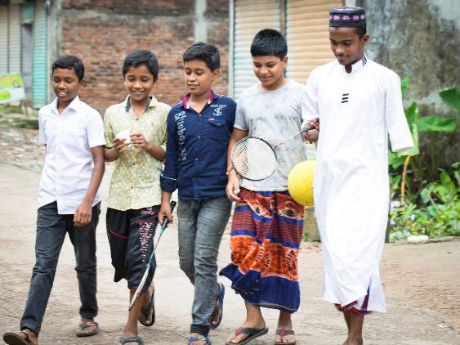
Other entry points for clusters
With significantly shorter sectoral chapters, other documents may be a more important focus for disability inclusion:
Other parts of HNRP:
Input into chapeau Quality, Inclusive and Accountable programming section
Monitoring framework
Cluster strategies

Slide 31
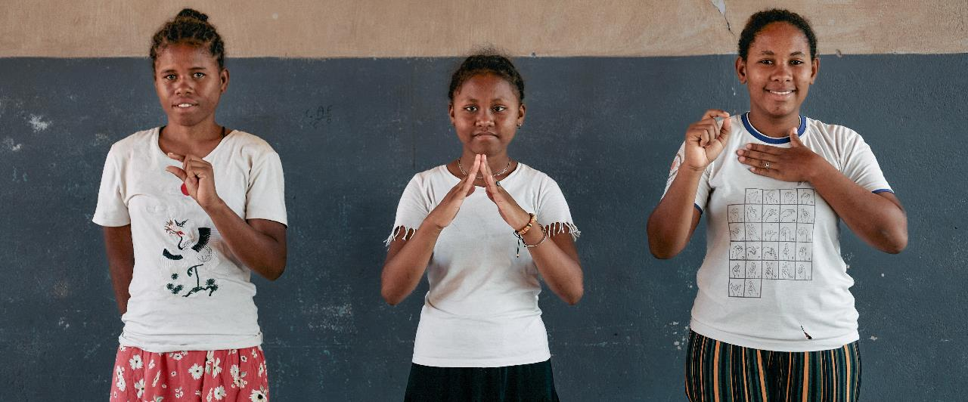

Presentation title
Thank you
© UNICEF/UNI460316/Andrianantenaina
Contact information
xxxx
Notes:
Please add contact details, depending on presenter and audience

